Slide 1
Testing your databases
Alessandro Alpi
@suxstellino
www.alessandroalpi.net

Slide 2







Sponsors

Slide 3



Organizers

Slide 4




About me
SQL Server MVP since 2008
Microsoft Certified
blogs:
[ITA] http://blogs.dotnethell.it/suxstellino
[ENG] http://suxstellino.wordpress.com/
More details on:
http://www.alessandroalpi.net

Slide 5
Agenda
ALM/DLM concepts
Unit Testing concepts
Why Unit Testing on databases
Unit Testing frameworks
Unit Testing solutions
Conclusions
Q&A

Slide 6
ALM definition
ALM is the product lifecycle management (governance, development, and maintenance) of application software. It encompasses requirements management, software architecture, computer programming, software testing, software maintenance, change management, project management, and release management.
(source: Wikipedia)

Slide 7
Why ALM?
Breaking the team barriers (integration)
Release high quality software
Release software in quickly way
Customer satisfaction
Improved work organization
Monitoring and tracking the activities
Improved code (clear and easy to read)

Slide 8
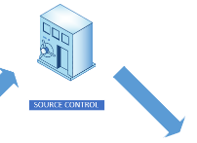
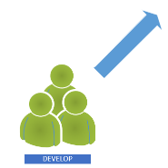
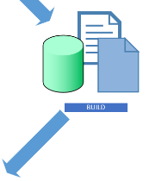

How to reach the best Quality?
Continuous Integration!
DEVELOP
SEND
BUILD
TEST

Slide 9
DLM – Database lifecycle management
DLM is a comprehensive approach to managing the database schema, data, and metadata for a database application. DLM begins with discussion of project design and intent, continues with database develop, test, build, deploy, maintain, monitor, and backup activities, and ends with data archive.
(source: TechNet)

Slide 10
Unit testing
In computer programming, unit testing is a software testing method by which individual units of source code, sets of one or more computer program modules together with associated control data, usage procedures, and operating procedures are tested to determine if they are fit for use. The primary purpose of this approach is to find out bugs and prevent regressions.
(source: Wikipedia)

Slide 11
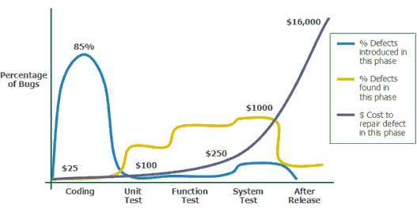
Unit testing – Why?
Notes:
Note that the cost of bugs rises. We know this. The earlier we find issues, the better. We can see from this survey that the cost of bugs rises dramatically as we get closer to the client.

Slide 12
Unit testing – Why?
Mission-critical business functionality
Evolutionary development
Usage of mock/fake objects
We’re missing bugs
We’re missing potential regressions
Notes:
Note that the cost of bugs rises. We know this. The earlier we find issues, the better. We can see from this survey that the cost of bugs rises dramatically as we get closer to the client.

Slide 13
Then..
«Fix bugs as soon as you find them»
Unfixed bugs camouflage other bugs
Unfixed bugs suggest quality isn’t important
Discussing unfixed bugs is a waste of time
Unfixed bugs lead to duplicate effort

Slide 14
Lesson learned..
Unfixed bugs lead to unreliable metrics
Unfixed bugs distract the entire team
Unfixed bugs hinder short-notice releases
Unfixed bugs lead to inaccurate estimates
Fixing familiar code is easier
Fixing a bug today costs less than tomorrow

Slide 15
Unit testing – What we usually do?
Executing the code on a copy of production data
Manual testing
T-SQL debug for checking variable values
PRINT, PRINT, SELECT…
Not repeatable and human errors (subjectivity)
Some test cases forgotten as the code changes.
Some test is made on structures with “test-unrelated” constraints which could break the test

Slide 16
Unit testing – What do I test?
Calculations in procedures and functions
Constraints (schema)
Edge cases of data DML
Expected behavior of data DML
Error Handling
Security
Standards

Slide 17
Unit testing – What can we use?
Frameworks
tSQLt
tSQLUnit
SQLCop
SS-Unit
Tools
SQLTest by Red-Gate (tSQLt + SQLCop)
Unit test project with Visual Studio

Slide 18

Unit testing – tSQLt
Free framework (open source)
T-SQL
Requires SQLCLR to be enabled
Includes common assertions
Self-contained tests
Isolated transactions
Versatile
Similar to xUnit

Slide 19
Unit testing – tSQLt structures
Built-in
tsqlt schema
Classes
Group of stored procedures (tests)
Model
Assemble (create fakes)
Act (apply logics)
Assert (verify results)
Conventions
Naming: test*

Slide 20

DEMO 1
tSQLt and Red-Gate SQL Test
+

Slide 21

Unit testing – Visual Studio
Visual Studio Data Tools
Unit test projects (created by template)
.Net + T-SQL
Supported also in VS 2013
Integrated Test UI (Test Explorer)
UI for test conditions
Pre/Post test scripts

Slide 22

DEMO 2
Visual Studio database unit testing projects
+

Slide 23
Unit testing – tSQLUnit
tSQLUnit
Free framework (open source)
T-SQL and SSMS
Self-contained tests
Isolated transactions
Versatile
Setup and reset
Similar to xUnit

Slide 24
Unit testing – tSQLUnit structures
tSQLUnit
TestSuites
Is the name after ut_ prefix
Groups of procedures
User defined test (prefix ut_)
ut_TestSuiteName_WhatToDo
Built-in
tsu_ procedures
Fixtures
_setup procedures
ut_TestSuiteName_setup
_teardown procedures
ut_TestSuiteName_teardown
They execute for each test in the suite

Slide 25

DEMO 3
tSQLUnit in SQL Server Management Studio
+
tSQLUnit

Slide 26
Features comparison – SQL Test
Pros
SSMS integration
Class execution
Messages and icons (UI)
T-SQL oriented
Self-contained
Supports tSQLt and SQLCop
Cons
Ui to be improved
Installs a set of objects
Needs SQLCLR
Needs TRUSTWORTHY ON

Slide 27
Features comparison – Visual Studio
Pros
Visual Studio ☺
Future support of project templates
Improved UI and designers
Does not need to add objects to database
Cons
Test project is not so comfortable
Test framework is not written in T-SQL
Out of SSMS (is this really a Con? ☺)
Different approaches on past VS versions

Slide 28
Features comparison – tSQLUnit
tSQLUnit
Pros
T-SQL oriented
Based on well known xUnit framework
Does not need SQLCLR
Open source
Cons
No UI
Installs a set of objects on the database
Poor T-SQL based documentation

Slide 29
Conclusions
There is no excuse for NOT testing like any other piece of code
Tools exist for testing
Tools exist for generating data
Testing processes improve the quality

Slide 30
Resources
http://www.red-gate.com/products/sql-development/sql-test/
http://tsqlt.org/
http://sourceforge.net/projects/tsqlunit/
http://msdn.microsoft.com/en-us/library/dd172118(v=vs.100).aspx (VS 2010)
http://blogs.msdn.com/b/ssdt/archive/2012/12/07/getting-started-with-sql-server-database-unit-testing-in-ssdt.aspx (SSDT)
http://msdn.microsoft.com/en-us/library/jj851200(v=vs.103).aspx (VS 2012)
http://channel9.msdn.com/Events/Visual-Studio/Launch-2013/QE107 (VS 2013)
http://msdn.microsoft.com/it-it/library/dn383992.aspx (Article on CI)
http://msdn.microsoft.com/en-us/library/jj907294.aspx (DLM)
http://en.wikipedia.org/wiki/Unit_testing
https://www.simple-talk.com/sql/t-sql-programming/getting-started-testing-databases-with-tsqlt/
http://utplsql.sourceforge.net/ (PL-SQL)
https://github.com/chrisoldwood/SS-Unit

Slide 31
Q&A
Questions?

Slide 32

Thanks!
#sqlsatPordenone
#sqlsat367
Feedback form: http://speakerscore.com/8N8C

